Slide 1
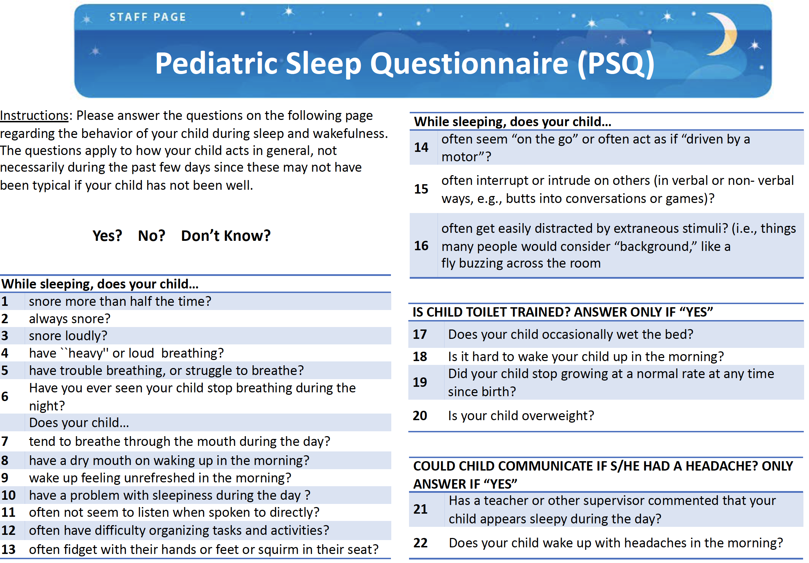
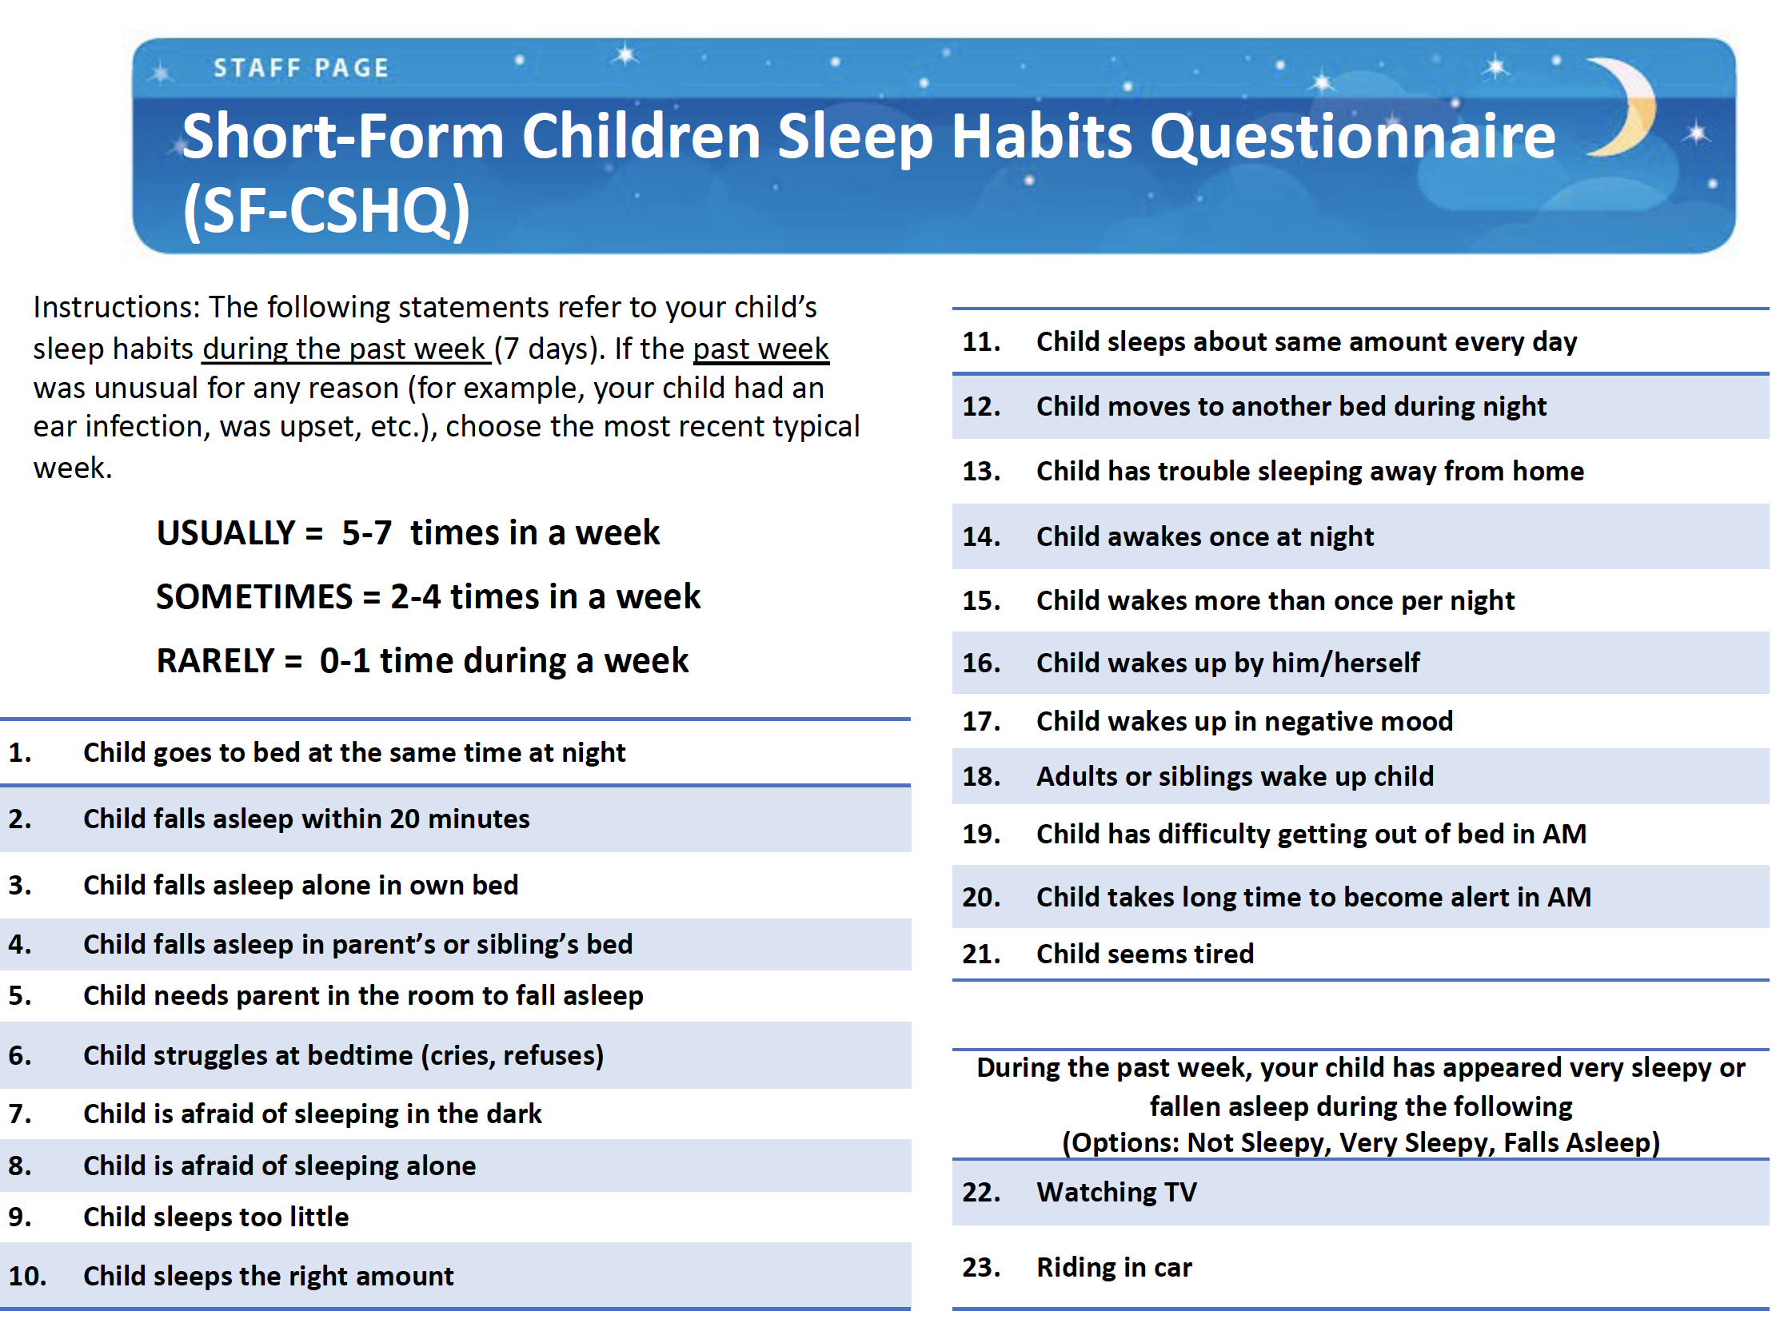
Speech-Language Pathologist Surveillance of Sleep Problems
Karen Bonuck, PhD, Ida Barresi MA, CCC-SLP, Risa Battino MS, CCC-SLP, BCS-F, Kathleen McGrath MSW,
Nancy Tarshis MS, MS, CCC-SLP Rose F. Kennedy UCEDD Bronx NY
RFK
UCEDD
THE PROBLEM
DESIGN & MEASURES
RESULTS: PARENT COMMENTS & SCORES
Impact
Rates of 20-50%
Aims
Explore- feasibility of SLP screening in practice
Collect- BSPs and SDB prevalence data
 | SDB+ | BSP+ | Parent
“[After melatonin treatment, his] sleep finally improved after years of restless nights that included co-sleeping, drinking bottles all night…” | 10 (+) | 37 (+) | Yes
“Recurring strep throat, ENT suggested sleep study…diagnosed with sleep apnea…never slept through the night on a regular basis...” | 14 (+) | 37 (+) | Yes
“… [sleep problems] about 1.5 years on…adenoids removed.” | 16 (+) | 53 (+) | Yes
“We understood why he couldn't sleep once diagnosed with ASD... doctor recommended melatonin 3 or 4 mg.” | 7 (-) | 38 (+) | Yes
“Night terrors have lessened; sometimes kicks, etc. in sleep; refuses to sleep without me.” | 8 (+) | 47 (+) | Yes
“He had two sleep studies.” | 14 (+) | 55 (+) | Yes
“ I'll just stare and watch him sleep, notice how he was breathing heavy… keep him up for a min then let him continue his sleeping.” | 11 (+) | 56 (+) | Yes
“Wakes up a lot throughout the night. Doctor didn't appear concerned.” | 4 (-) | 32 (+) | Yes
“Child will not fall asleep unless mother goes to sleep with him. If mother wakes up or awakes from bed, he will as well.” | 6 (-) | 40 (+) | No
“Neurologist gave medicine, took it for 6 months, no problems now.” | 7 (-) | 53 (+) | No
“He does not sleep the required amount of hours. He only sleeps maybe 7 hours.” | 7 (-) | 28 (-) | Maybe
“…staying awake as much as she can… wondering (sharing a bedroom) is not good for kids.” | 9 (+) | 46 (+) | Maybe
Social-emotional
Cognitive
Obesity
Life-long
Sleep Problems:
Not Enough
Behavioral (BSP)
Respiratory (SDB)
Setting & Sample
RFK Children’s Evaluation & Rehabilitation Center- Bronx NY
2-6 y olds, evaluated or treated by SLPs
Methods
Focus Groups- pre/post screening of sample
Measures- BSP & SDB Questionnaires; Parent Report (Y/N)
THE EVIDENCE
Sleep affects child development via effects on: brain growth, learning & memory, executive function (EF) and weight such as:
Not Enough Sleep: ↓ verbal IQ ↑ behavior issues ↑ obesity Behavioral Sleep Problem: ↑ inattention & hyperactivity ↓ EF
Sleep Disordered Breathing- 12.3% ↓ language arts grades
Sleep Problem Questionnaires: SDB: range 0-22; cut-off >8
BSP: range 21-67. cut-off >30
WHY SPEECH-LANGUAGE PATHOLOGISTS (SLPs)?
SLP scope: articulation, communication, pragmatics & literacy
Functional Overlap: both sleep and language problems impair social-emotional and cognitive function.
CONCEPT MODEL
RESULTS: QAIRE SCORES & FOCUS GROUPS
SUMMARY & NEXT STEPS
SLPs Screen:
for Sleep Problems
Speech-Language:
↑ Speech-Lang Risk Factor Detection
Sleep:
↑ Sleep Disorder Surveillance
Summary- Young children in speech and language services have high rates of sleep problems. Yet, SLPs receive limited/no training about pediatric sleep - even though parents often raise the topic with them. In fact, many parents are aware of their child’s sleep problems and seek treatment them. SLPs are both eager and uniquely positioned to integrate sleep problems screening into their practice. Next Steps- Paper under review at American Journal of Speech Language Pathology. After publication, seeking research partners to implement a larger study.
Training:
limited to “you know, kids need their sleep.”
Presentation:
“younger the kids, more often it comes up”
“kids are on the spectrum, it will come up”
Implement Screening?
“I would consider it part of my profession.”
“If these kids aren’t sleeping, then who feels like sitting, learning, concentrating.”
Logistics:
Weekly sessions build rapport; facilitates trust
Screeners took 10-15 minutes; would need training
This research was supported by a grant from the American Sleep Medicine Foundation and the AIDD UCEDD core grant. We thank the families who participated and the SLP team at the RFK UCEDD: Sarah Warnet, Jessica Bonilla, Noor Al Radi, Minna Park, Daniela Cavalieri, Samantha Siminerio, Tamelly Jimenez

